Slide 1
Problem Solving Agent State Space Representations
Chapter - 03

Slide 2
Problem solving agent- Goal Based Agent
Decide what to do by finding sequence of actions
that lead to desirable states ( GOAL)
A state is a situation that an agent can find itself in.

Slide 3
Problem Solving Agent
Rational agents need to perform sequences of actions in order to achieve goals.
Intelligent behavior can be generated by having a look-up table or reactive policy that tells the agent what to do in every circumstance, but:
Such a table or policy is difficult to build
All contingencies must be anticipated
Notes:
Contingencies – Uncertainity.

Slide 4
Types of States
World states : the actual concrete situations in the real world
Representational states : the abstract descriptions of the real world that are used by the agent in deliberating about what to do

Slide 5
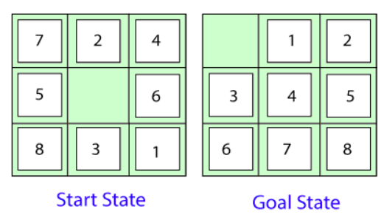
Problem Solving Agent
A more general approach is for the agent to have knowledge of the world and how its actions affect it and be able to simulate execution of actions in an internal model of the world in order to determine a sequence of actions that will accomplish its goals.
This is the general task of problem solving and is typically performed by searching through an internally modelled space of world states.

Slide 6
Problem Solving task
Given:
An initial state of the world
A set of possible actions or operators that can be performed.
A goal test that can be applied to a single state of the world to determine if it is a goal state.
Find:
A solution stated as a path of states and operators that shows how to transform the initial state into one that satisfies the goal test.
The initial state and set of operators implicitly define a state space of states of the world and operator transitions between them. May be infinite.

Slide 7
Problem-solving agent
Four general steps in problem solving:
Goal formulation
What are the successful world states
Problem formulation
What actions and states to consider give the goal
Search
Determine the possible sequence of actions that lead to the states of known values and then choosing the best sequence.
Execute
Give the solution perform the actions.

Slide 8
Steps Performed by Problem-solving agent
Problem Formulation: Most important step of problem-solving which decides what actions should be taken to achieve the formulated goal.
Five components involved in problem formulation:
Initial State: It is the starting state or initial step of the agent towards its goal.
Actions: It is the description of the possible actions available to the agent.
Transition Model: It describes what each action does.
Goal Test: It determines if the given state is a goal state.
Path cost: It assigns a numeric cost to each path that follows the goal. The problem-solving agent selects a cost function, which reflects its performance measure. Remember, an optimal solution has the lowest path cost among all the solutions.

Slide 9
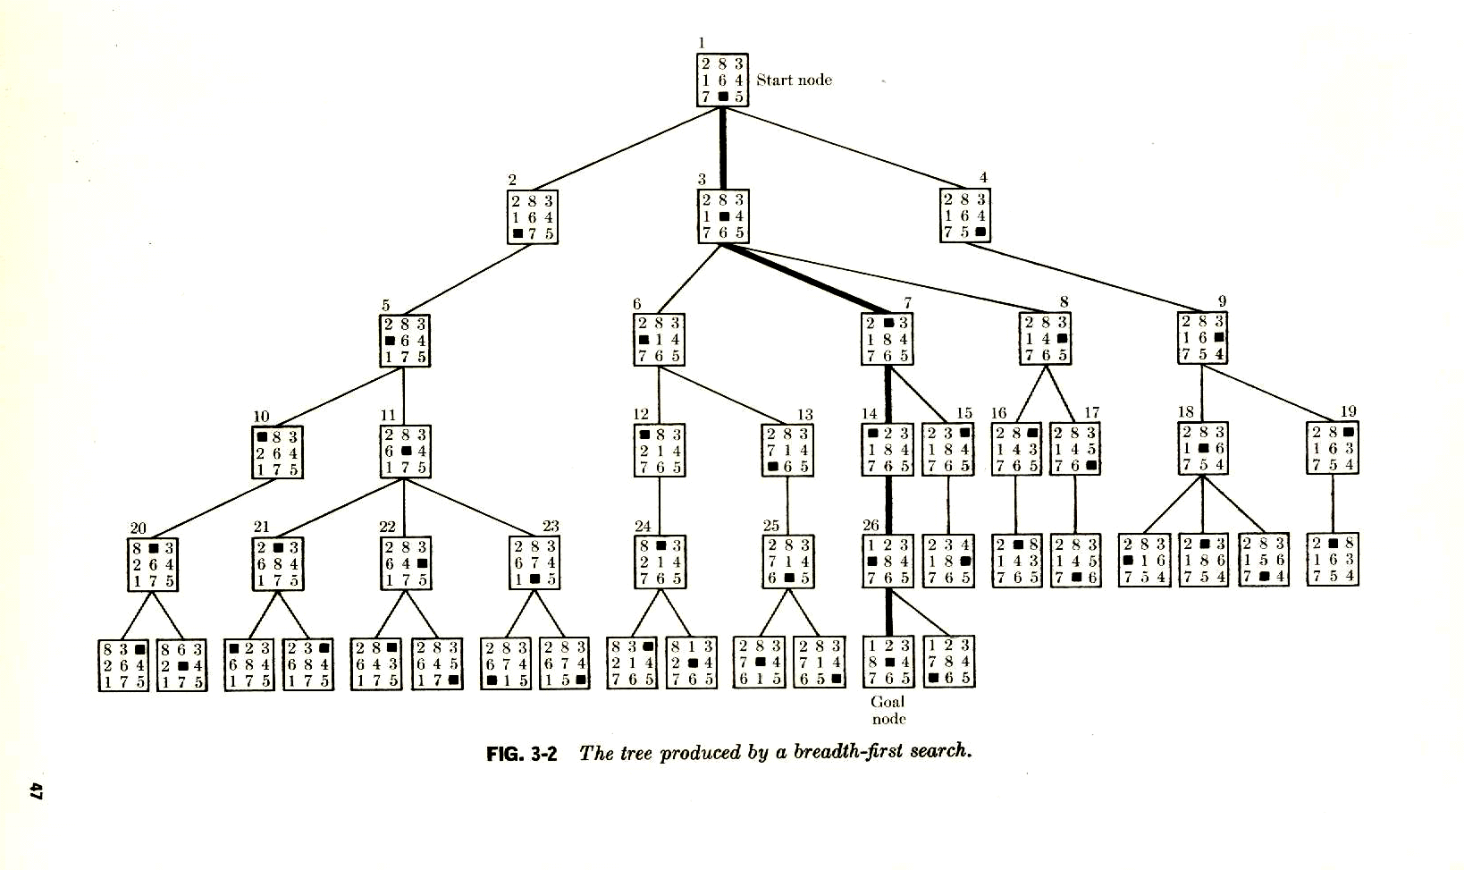
Start state
Searching for a solution
to the 8-puzzle.
Aside: in this tree, immediate
duplicates are removed.
Goal
A breadth-first search tree. (More detail soon.)
Branching factor 1, 2, or 3 (max). So, approx. 2 --- # nodes roughly doubles at each level. Number states of explored nodes grows exponentially with depth.

Slide 10
Example Problems : Activity
Vacuum Cleaner Agent
Travel Salesman Problem – Pathfinding to Romania
8 Queens problem
8 Puzzle Problem
Robot Block World
Missionaries and Cannibals

Slide 11
State Space and Search Tree
A state space : a graph whose nodes are the set of all states, and whose links are actions that transform one state into another.
A search tree : a tree (a graph with no undirected loops) in which the root node is the start state and the set of children for each node consists of the states reachable by taking any action.

Slide 12
Defining Search Problems
A statement of a Search problem has 4 components
1. A set of states
2. A set of “operators” which allow one to get from one state to another
3. A start state S
4. A set of possible goal states, or ways to test for goal states
5 Cost path
A solution consists of
a sequence of operators which transform S into a goal state G
Representing real problems in a State-Space search framework
may be many ways to represent states and operators
key idea: represent only the relevant aspects of the problem (abstraction)

Slide 13
Problem Formulation
Process of deciding what actions and states to consider , given a goal.
E.g. travel within Maharashtra– map can be given as input , Mumbai to Pune.
Agent can decide what to do by – -
Examining different possible sequence of actions that lead to states of known values.
Then choosing the best sequence.
This process of looking for such sequence is called as “search”

Slide 14
Problem-Solving Agents
Intelligent agents can solve problems by searching a state-space
State-space Model
The agent’s model of the world
Usually a set of discrete states
E.g., in driving, the states in the model could be towns/cities
Goal State(s)
A goal is defined as a desirable state for an agent
There may be many states which satisfy the goal test
e.g., drive to a town with a ski-resort
OR just one state which satisfies the goal
e.g., drive to Pune
Operators (actions, successor function)
operators are legal actions which the agent can take to move from one
state to another

Slide 15
Search
Problem As Input
Search Algorithm
Returns Solution in
form of action sequence
Steps :
Formulate Problem
Search
Execute Solution
7

Slide 16
Initial Simplifying Assumptions
Environment is static
no changes in environment while problem is being solved
Environment is observable
Environment and actions are discrete
Environment is deterministic

Slide 17
Go
Bom
Lona
vala
Tale
gaon
Pune
Problem Formulation
Problem can be defined by four elements:
Initial State
Goal State
: In( Bombay)
: In ( Pune)
Description of possible actions available to agent
SUCCESSOR_FN(x)🡪 returns ( action, successor)
E.g. {<Go(Lonavala), In ( Bombay)>,
<Go( Talagaon),In (Lonavala)>,
<Go(pune), In(pune)> }
State Space – Initial state and successor function implicitly define state space of problem. It can represented using Graph where nodes are states and arcs are actions.
9

Slide 18
The state-space graph
Graphs:
nodes, arcs, directed arcs, paths
Search graphs:
States are nodes
operators are directed arcs
solution is a path from start to goal
Problem formulation:
Give an abstract description of states, operators, initial state and goal state.
Problem solving activity:
Generate a part of the search space that contains a solution

Slide 19
Problem Formulation
Path : in state space is sequence of states connected by sequence of actions
Goal Test : Determines whether given state is goal state.
Goal state can be Explicit / Implicit e.g. in chess – ‘checkmate”
Step Cost : It is cost of taking action a to go from state x to y .
Cost( x, a, y )
Solution : Solution to problem is a path from initial state to goal state.
Solution Quality : Measured by Path Cost function and optimal solution
Abstraction : Removing details from representation e.g. weather condition, rains, etc.
11

Slide 20
Example: Traveling from Mumbai to Pune
Initial State: currently in Mumbai
Formulate goal:
be in PUNE
Formulate problem:
states: various cities
actions/operators: drive between cities
Find solution
By searching through states to find a goal
sequence of cities, e.g., Lonavala, Talegaon, Baner, Pune
Execute states that lead to a solution

Slide 21
Robot block world
Given a set of blocks in a certain configuration,
Move the blocks into a goal configuration.
Example :
(c,b,a) 🡪 (b,c,a)
A
B
C
A
C
B
Move (x,y)

Slide 22
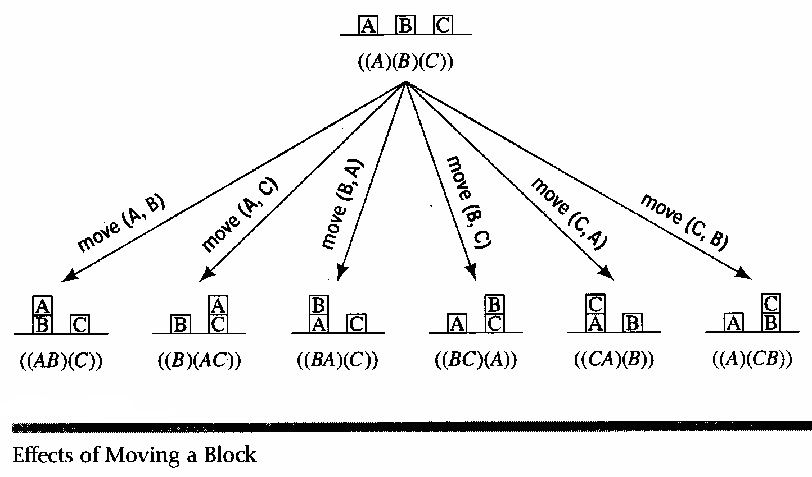
Operator Description

Slide 23
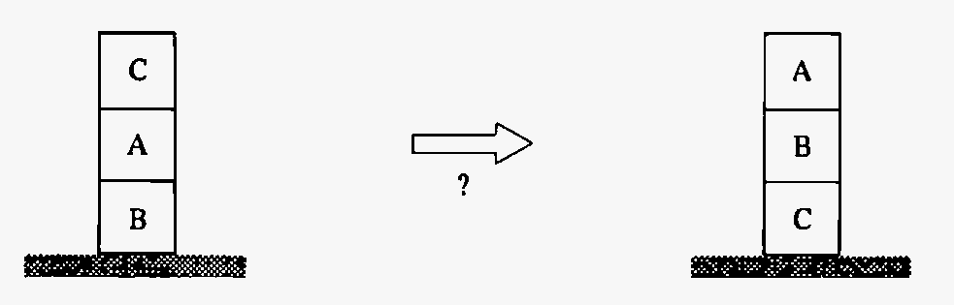
A problem from blocks world
Find a sequence of robot moves to re-arrange blocks

Slide 24
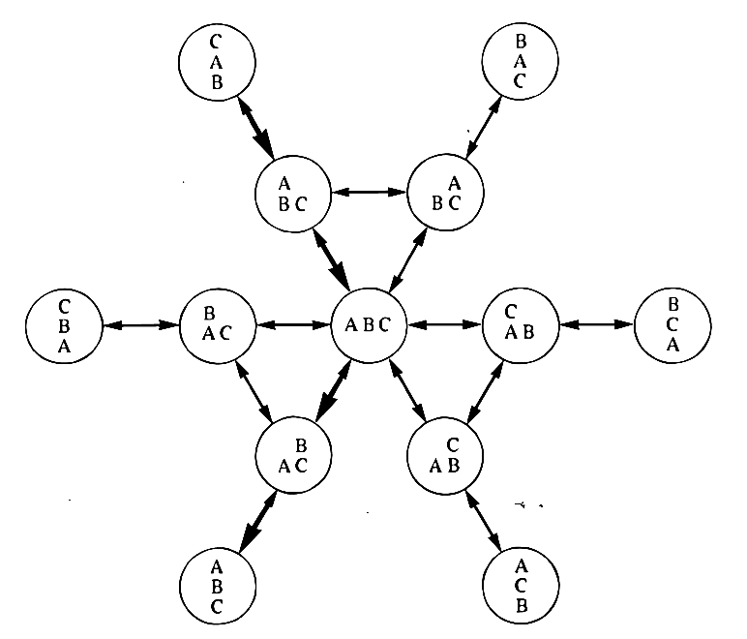
Blocks world state space
Start
Goal

Slide 25
State Space
State space = Directed graph
Nodes ~ Problem situations
Arcs ~ Actions, legal moves
Problem = ( State space, Start, Goal condition)
Note: several nodes may satisfy goal condition
Solving a problem ~ Finding a path
Problem solving ~ Graph search
Problem solution ~ Path from start to a goal node

Slide 26
Vacuum Cleaner Agent
Initial State : Any state that is designated as initial state
Goal State / Test : check whether all squares are clean
States : Agent in one of two locations each of which might / or might not contain dirt
Successor Function : actions ( left, right, suck)
Path Cost : each step cost 1 – number of steps in the path.
21

Slide 27
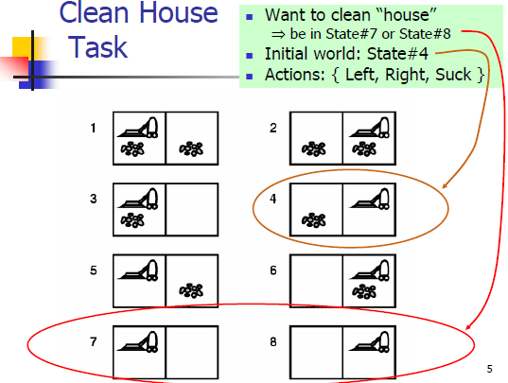
Vacuum Cleaner Agent

Slide 28
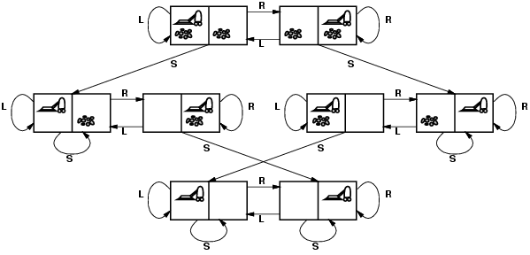
Vacuum world state space graph
states?
actions?
goal test?
path cost?

Slide 29
Vacuum world state space graph
states? integer dirt and robot location
actions? Left, Right, Suck
goal test? no dirt at all locations
path cost? 1 per action

Slide 30
Example: 8-queen problem

Slide 31




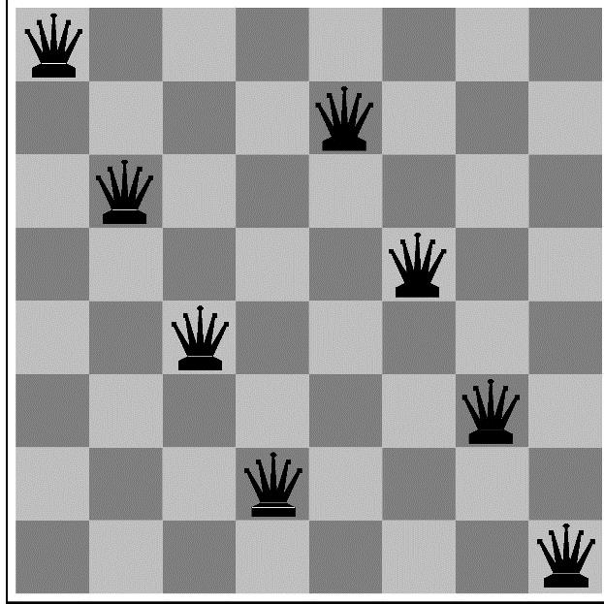
Example: 8-Queens
states? -any arrangement of n<=8 queens
-or arrangements of n<=8 queens in leftmost n columns, 1 per column, such that no queen attacks any other.
initial state? no queens on the board
actions? -add queen to any empty square
-or add queen to leftmost empty square such
that it is not attacked by other queens.
goal test? 8 queens on the board, none attacked.
path cost? 1 per move

Slide 32
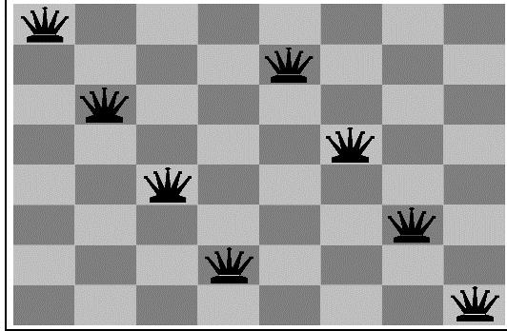
8 queens – sol 2
State : any arrangement of 8 Q on board
Initial state : all Q at column 1
Successor : change position of one Q
Operator : move
8 queens – sol 3
State : any arrangement of 8 Q on board
Initial state : all Q at row 1
Successor : change position of one Q
Operator : move
29

Slide 33
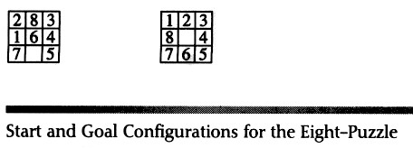
The sliding tile problem
8-puzzle: 181,440 states
15-puzzle: 1.3 trilion 24-puzzle: 10^25

Slide 34
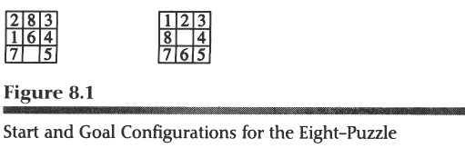
The Sliding Tile Problem
move(x,loc y,loc z)
Up Down Left Right

Slide 35

The “8-Puzzle” Problem
Start State
1 | 2 | 3
4 |  | 6
7 | 5 | 8
1 | 2 | 3
4 | 5 | 6
7 |  | 8
1 | 2 | 3
4 | 5 | 6
7 | 8
Goal State

Slide 36
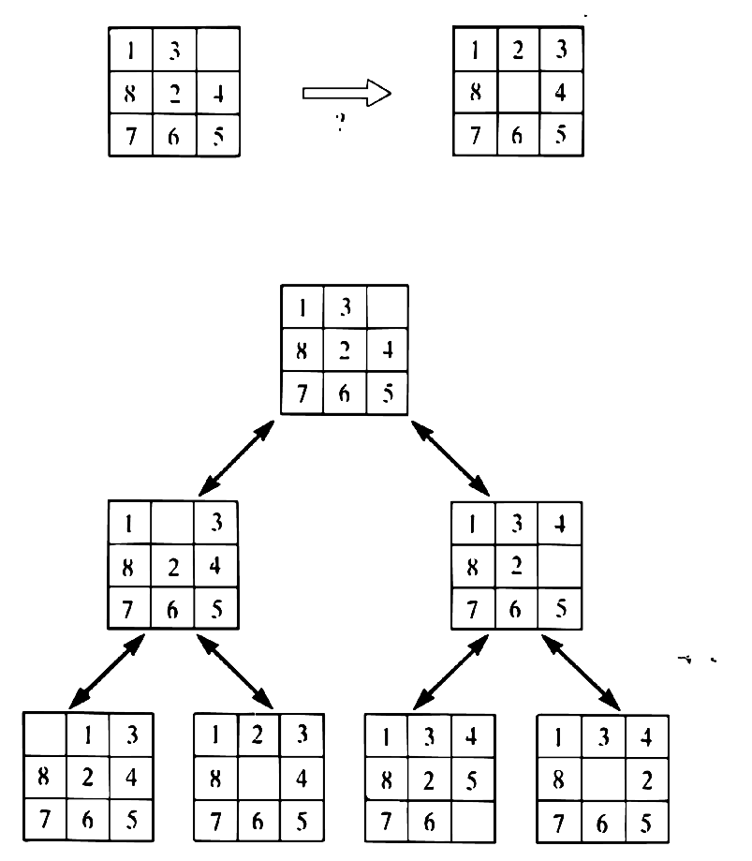
8 puzzle
Initial State
Final State
33

Slide 37

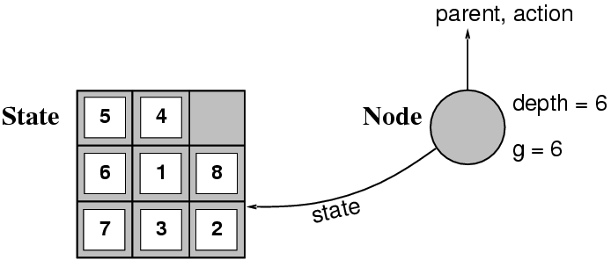
States versus Nodes
A state is a (representation of) a physical configuration
A node is a data structure constituting part of a search tree contains info such as: state, parent node, action, path cost g(x), depth
The Expand function creates new nodes, filling in the various fields and using the SuccessorFn of the problem to create the corresponding states.

Slide 38
State Spaces versus Search Trees
State Space
Set of valid states for a problem
Linked by operators
e.g., 20 valid states (cities) in the Romanian travel problem
Search Tree
Root node = initial state
Child nodes = states that can be visited from parent
Note that the depth of the tree can be infinite
E.g., via repeated states
Partial search tree
Portion of tree that has been expanded so far
Fringe - Leaves of partial search tree, candidates for expansion Search trees = data structure to search state-space

Slide 39
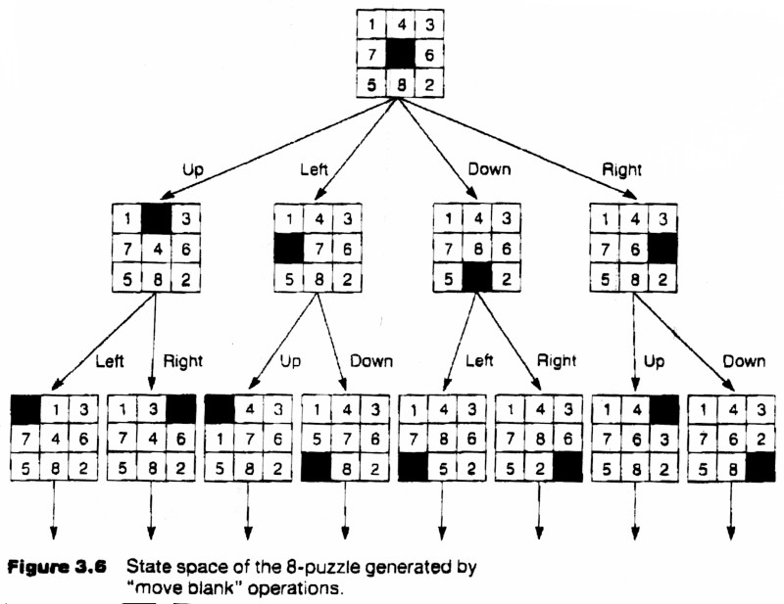
Search Tree for the 8 puzzle problem

Slide 40
Summary
Intelligent agents can often be viewed as searching for problem solutions in a discrete state-space
Space obtained through a problem abstraction process.
Search consists of
state space
operators
start state
goal states
A Search Tree is an efficient way to represent a search
There are a variety of general search techniques, including
Depth-First Search
Breadth-First Search

Slide 41
State Space Representation using Variables
47

Slide 42
Give the initial state, goal test, successor and cost function for Water Jug Problem.

Slide 43
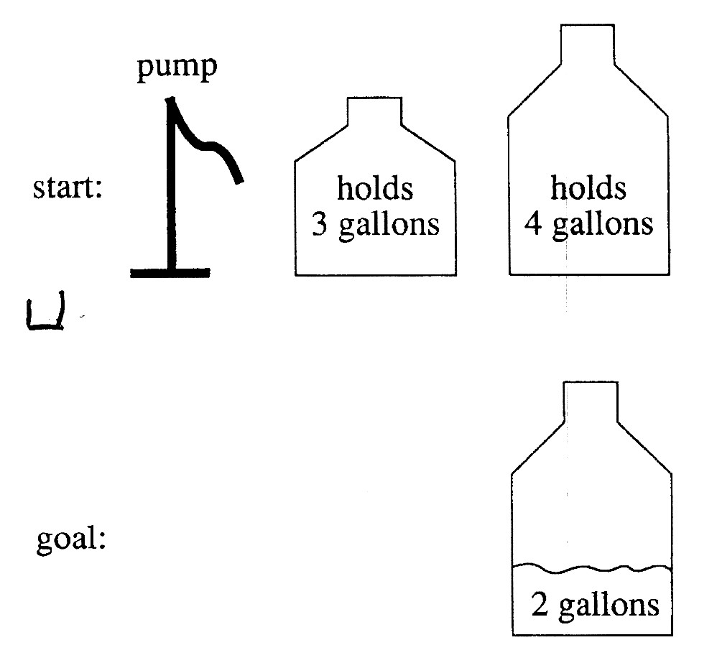
A Water Jug Problem
You have a 4-gallon and a 3-gallon water jug
You have a faucet with an unlimited amount of water
You need to get exactly 2 gallons in 4- gallon jug

Slide 44

Puzzle-solving as Search
State representation: (x, y)
x: Contents of four gallon
y: Contents of three gallon
Start state: (0, 0)
Goal state (2, n)
Operators
Fill 3-gallon from pump, fill 4-gallon from pump
Fill 3-gallon from 4-gallon , fill 4-gallon from 3-gallon
Empty 3-gallon into 4-gallon, empty 4-gallon into 3- gallon
Dump 3-gallon down drain, dump 4-gallon down drain

Slide 45
Production Rules for the Water Jug
Problem
1 (x,y) 🡪 (4,y) if x < 4
2 (x,y) 🡪 (x,3) if y < 3
3 (x,y) 🡪 (x – d,y) if x > 0
4 (x,y) 🡪 (x,y – d) if x > 0
5 (x,y) 🡪 (0,y) if x > 0
6 (x,y) 🡪 (x,0) if y > 0
7 (x,y) 🡪 (4,y – (4 – x))
if x + y ≥ 4 and y > 0
Fill the 4-gallon jug
Fill the 3-gallon jug
Pour some water out of the 4-gallon jug
Pour some water out of the 3-gallon jug Empty the 4-gallon jug on the ground Empty the 3-gallon jug on the ground
Pour water from the 3-gallon jug into the 4-
gallon jug until the 4-gallon jug is full

Slide 46
The Water Jug Problem
8 (x,y) 🡪 (x – (3 – y),3)
if x + y ≥ 3 and x
> 0
9 (x,y) 🡪 (x + y, 0) if x + y ≤ 4 and y
> 0
10 (x,y) 🡪 (0, x +
y)
if x + y ≤ 3 and x
> 0
Pour water from the 4-gallon jug into the 3-gallon jug until the 3-gallon jug is full
Pour all the water from the 3- gallon jug into the 4-gallon jug
Pour all the water from the 4- gallon jug into the 3-gallon jug

Slide 47

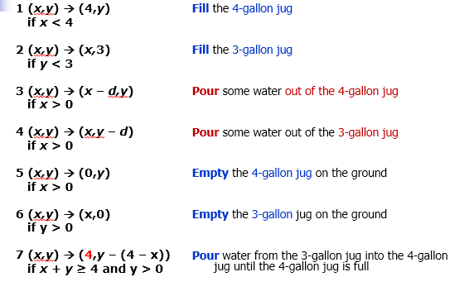
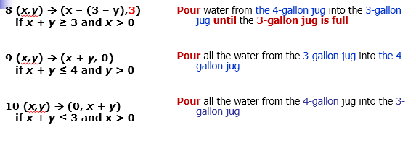
One Solution to the Water Jug Problem
Gallons in the 4-Gallon Jug | Gallons in the 3- Gallon Jug | Rule Applie d
0 | 0 | 2
0 | 3 | 9
3 | 0 | 2
3 | 3 | 7
4 | 2 | 5
0 | 2 | 9
2 | 0
2. Fill the 3-gallon jug
9. Pour all the water from the 3-gallon jug into the 4- gallon jug
2 . Fill the 3-gallon jug
7. Pour water from the 3-gallon jug into the 4-gallon jug until the 4-gallon jug is full
5. Empty the 4-gallon jug on the ground
9. Pour all the water from the 3-gallon jug into the 4- gallon jug

Slide 48
Exercise 2

Slide 49
Water Jug Problem II
Given a full 5-gallon jug and an empty 2-gallon jug, the goal is to fill the 2-gallon jug with exactly one gallon of water. You may use the following state space formulation.
State = (x,y), where x is the number of gallons of water in the 5-gallon jug and y is # of gallons in the 2- gallon jug
Initial State = (5,0)
Goal State = (*,1), where * means any amount

Slide 50

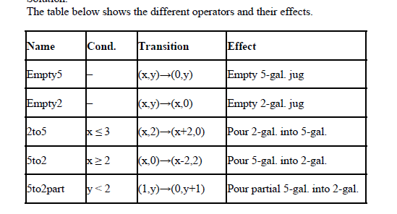
Water Jug Problem II

Slide 51
The basic search algorithm
Initialize: put the start node into OPEN while OPEN is not empty
take a node N from OPEN
if N is a goal node, report success put the children of N onto OPEN
Report failure
If OPEN is a stack, this is a depth-first search
If OPEN is a queue, this is a breadth-first search
If OPEN is a priority queue, sorted according to most promising first, we have a best-first search

Slide 52
Tree-based Search
Basic idea:
Exploration of state space by generating successors of already-explored states (a.k.a. expanding states).
Every state is evaluated: is it a goal state?
In practice, the solution space can be a graph, not a tree
E.g., 8-puzzle
More general approach is graph search
Tree search can end up repeatedly visiting the same nodes
Unless it keeps track of all nodes visited
…but this could take vast amounts of memory

Slide 53
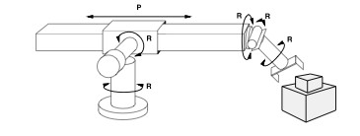
Problem 3: Robot Assembly
States:?
Initial state:?
Actions:?
Goal test:?
Path Cost:?

Slide 54
Example: Robot Assembly
States: configuration of robot (angles, positions) and object parts
Initial state: any configuration of robot and object parts
Actions: continuous motion of robot joints
Goal test: object assembled?
Path Cost: time-taken or number of actions

Slide 55
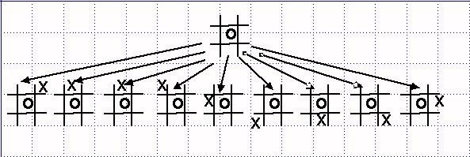
Problem 4
Tic Tack Too Game – draw state space representation, initial and goal state, operators etc.

Slide 56
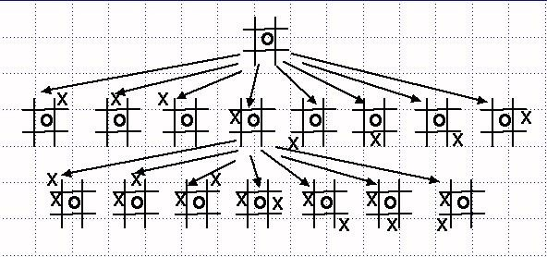
The entire set of possible states makes up the State Space for the game

Slide 57
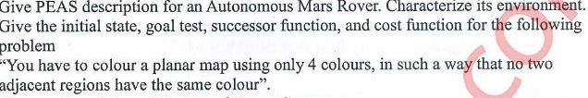
Practice Questions

Slide 58
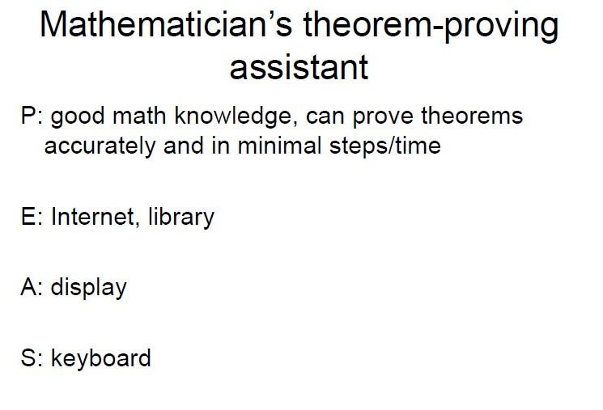
PEAS Descriptor

Slide 59
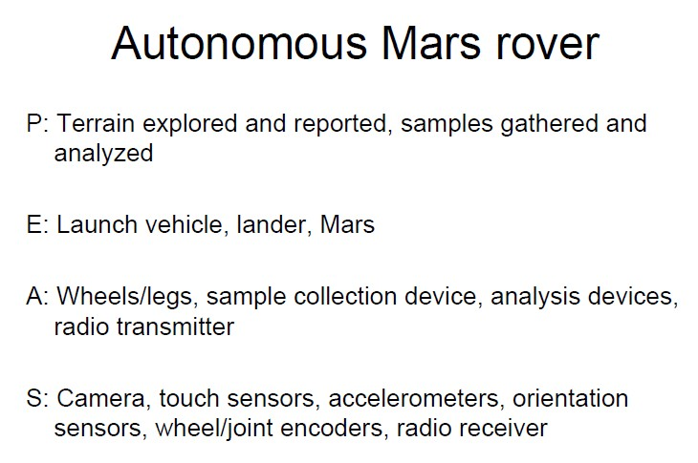
PEAS Descriptor

Slide 60

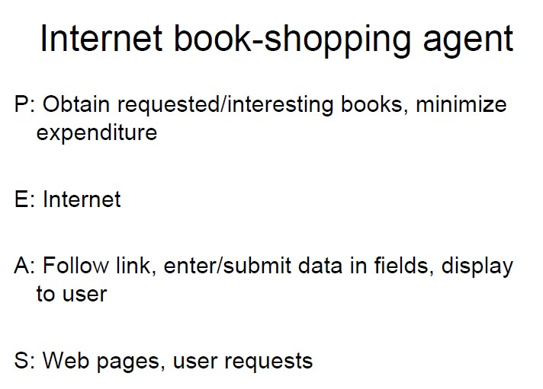
PEAS Descriptor

Slide 61
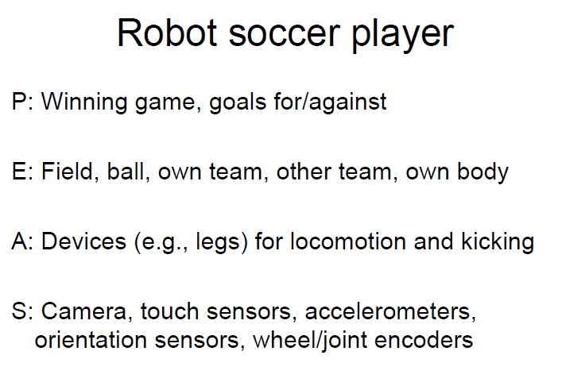
PEAS Descriptor

Slide 62

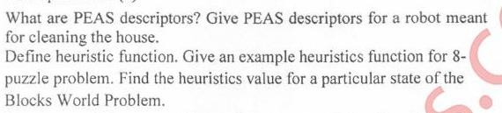

Slide 63
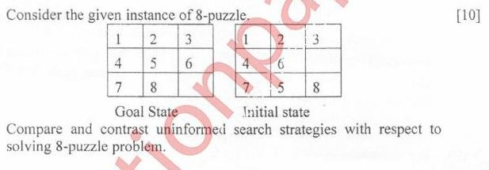

Slide 64
Graph Coloring
Graph coloring is the problem of coloring each vertex in a graph such that no two adjacent vertices are the same color
Some direct examples:
Map coloring

Slide 65
Graph Coloring
We want to prune the state-space tree as soon as we find something that
won’t work
This implies that we need a sequence of vertices to color
As we color the next vertex we need to make sure it doesn’t conflict with any of its previously colored neighbors
We may need to backtrack

Slide 66
Graph Coloring
As an example:
The vertices are enumerated in order A- F
The colors are given in order: R, G, B
A
B
F
C
E
D

Slide 67
Graph Coloring
A
B
F
C
E
D

Slide 68
Graph Coloring
A
B
F
C
E
D

Slide 69
Graph Coloring
A
B
F
C
E
D

Slide 70
Graph Coloring
A
B
F
C
E
D

Slide 71
Graph Coloring
A
B
F
C
E
D

Slide 72

Graph Coloring
A
B
F
C
E
D

Slide 73

Graph Coloring
A
B
F
C
E
D

Slide 74

Graph Coloring
A
B
F
C
E
D

Slide 75
Graph Coloring
A
B
F
C
E
D

Slide 76
Graph Coloring
A
B
F
C
E
D

Slide 77
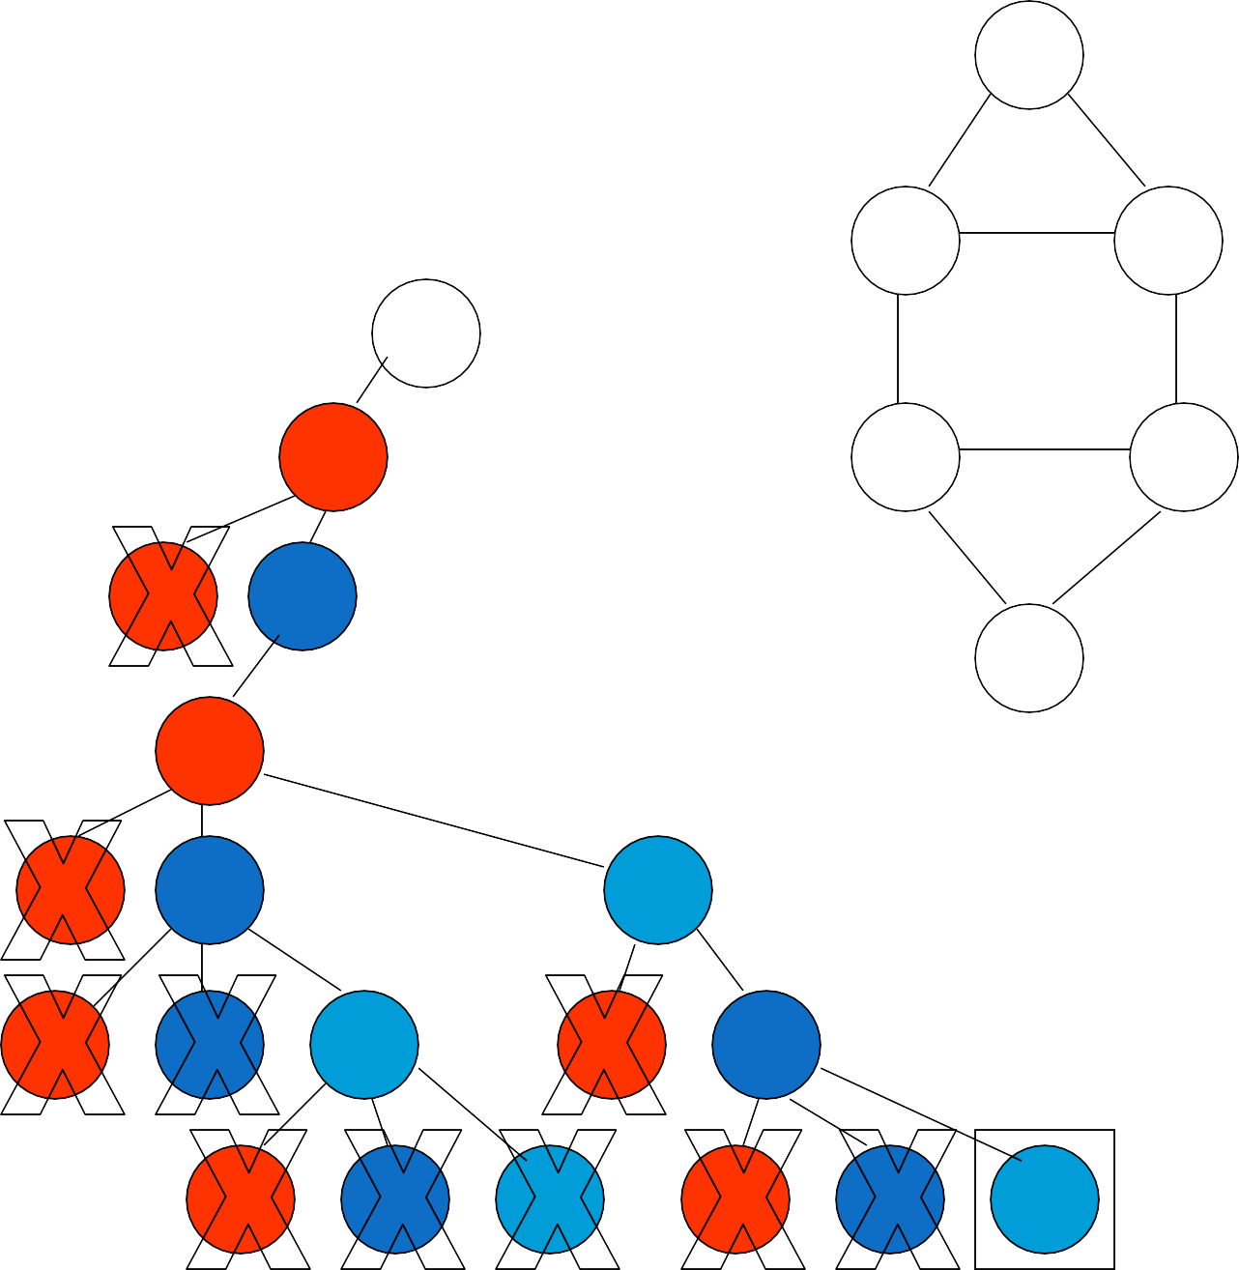
Graph Coloring
A
B
F
C
E
D

Slide 78
The Traveling Salesperson Problem (a touring problem)
Find the shortest tour that visits all cities without visiting any city twice and return to starting point.
States: sequence of cities visited
S₀ = A
C
B
A
D
F
S_{G} = a complete tour
{a, c, d} {(a, c, d, x) | X ∉ a, c, d}
E

Slide 79
Exercises
Three missionaries and three cannibals come to a river. There is a boat on their side of the river that can be used by either one or two persons. How should they use this boat to cross the river in such a way that cannibals never outnumber the missionaries on either side of the river.
Specify the form of state description, the initial state and the goal state for this problem. Describe the state space using variables (as if you are using an array in a program). Determine how many states are in state space.
Describe the set of operators using if-then rules.
Draw the entire state space graph (include only legal states, that is, states in which cannibals do not outnumber missionaries on either side of the river)

Slide 80
Exercises

Slide 81
Example 3: Missionaries and cannibals
An old puzzle is the “Missionaries and cannibals” problem
The missionaries and cannibals wish to cross a river
They have a boat that can hold two people
It is unsafe to have cannibals outnumber missionaries
_{M} M
C
M
M
_{M} C _{C}
M
C
C _{C}
Initial state
Goal state

Slide 82
States
A state can be represented by the number of missionaries and cannibals on each side of the river
Initial state: 3m,3c,boat
Goal state: 0m,0c / 3m,3c,boat
We assume that crossing the river is a simple procedure
that always works (so we don’t have to represent the boat
being in the middle of the river)
However, this is redundant; we only need to represent how
many missionaries/cannibals are on one side of the river
Initial state: 3m,3c,boat
Goal state: 0m,0c

Slide 83

Operations
An operation takes us from one state to another
Here are five possible operations:
Boat takes 1 missionary across river (1m)
Boat takes 1 cannibal across river (1c)
Boat takes 2 missionaries across river (2m)
Boat takes 2 cannibals across river (2c)
Boat takes 1 missionary and 1 cannibal across river (1m1c)
We don’t have to specify “west to east” or “east to west” because only one of these will be possible at any given time

Slide 84

The state space
3m, 0c,
1c
3m,1c,boat
3m, 2c
etc.
2m
1c
2c
3m, 1c
etc.
1m,1c
1m 1c
1m
1c
2c
3m, 3c, b oat
2m, 3c
2m,2c,boat
2m
2m
3m, 2c, boat
1m, 3c
0m,2c
1m1c
1m
1c
2m, 2c
0m,3c, boat
2m, 3c, boat
2c
1c
1m1c
1c
0m,1c
2c
0m,2c
0m,0c

Slide 85
Example : Missionaries and cannibals
3 missionaries, 3 cannibals, 1 boat
The boat can hold at most two people
Cannibals may never outnumber missionaries (on either side)
Initial state is (3, 3, 1), representing the number of missionaries, cannibals, boats on the initial side
The goal state is (0, 0, 0)
Operators are addition or subtraction of the vectors
(1 0 1), (2 0 1), (0 1 1), (0 2 1), (1 1 1)
Operators apply if result is between (0 0 0) and (3 3 1)

Slide 86
Search Strategies
A search strategy is defined by picking the order of node expansion
Strategies are evaluated along the following dimensions:
Completeness: does it always find a solution if one exists?
Time complexity: number of nodes generated
space complexity: maximum number of nodes in memory
optimality: does it always find a least-cost solution?
Time and space complexity are measured in terms of
b: maximum branching factor of the search tree
d: depth of the least-cost solution
m: maximum depth of the state space (may be ∞)

Slide 87
State-space searching
Most problems in AI can be cast as searches on a state space
The space can be tree-shaped or graph-shaped
If a graph, need some way to keep track of where you have been, so as to avoid loops
The state space is often very, very large
We can minimize the size of the search space by careful choice of operators
Exhaustive searches don't work—we need heuristics

